Slide 1

Be United
1 Kings
Dr. Rick Griffith • Crossroads International Church Singapore
CICFamily.com • BibleStudyDownloads.org

Slide 2
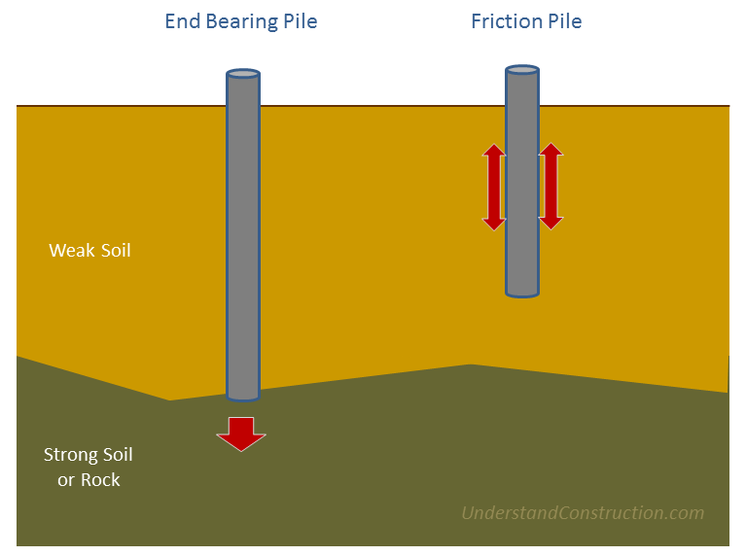
Millennium Tower
San Francisco
End Bearing Pile
Friction Pile
Weak Soil
(80 feet)
Strong Soil
or Rock
(200 feet)
Notes:
... Some critics blame the city of San Francisco for allowing Millennium Partners to anchor the building 80 feet into packed sand rather than 200 feet down to bedrock.
___________
ESA satellite watches San Francisco’s Millennium Tower sinking from space
By Ryan Whitwam on November 30, 2016 at 11:29 am
https://www.extremetech.com/extreme/240287-esa-satellite-watches-san-franciscos-millennium-tower-sinking-space
Accessed 30 Dec 2017
San Francisco’s Millennium Tower is the tallest building in the city at 58-stories, filled with luxury condos inhabited by some very annoyed people. The building has gained a reputation as the “leaning tower of San Francisco” since is was revealed earlier this year that it’s started sinking and tilting. The building developer has claimed that the sinking was slowing and would stop soon, but a new satellite analysis from the ESA says otherwise. If anything, Millennium Tower appears to be sinking even faster.
This residential skyscraper cost more than $350 million to build, and he most expensive penthouse condos sold for around $12 million. However, the city of San Francisco now alleges Mission Street Developers LLC cut corners and did not properly disclose the structural issues to owners of the condos. The building has sunk approximately 16 inches downward, and there’s a northwest tilt of 2-inches at the base and 6-inches at the top. Some in San Francisco say you can see the minor tilt from a sufficient distance away, but that might be confirmation bias.
The European Space Agency (ESA) decided to conduct observations of the San Francisco Bay area because it includes the earthquake-prone Hayward Fault. The analysis was conducted with the ESA’s Sentinel-1 satellites. There are two of these satellites in orbit at an altitude of 400 miles. The goal of Sentinel-1 is to track urban ground movement and fault activity around the world using radar, particularly subsistence hotspots in Europe. That also means it can take very accurate measurements of the Millennium Tower.
The image above uses colored dots to show change over time from the satellite’s perspective. The red dots at the top of the tower indicate it has moved nearly 40mm away from the satellite. Overall, the ESA estimates the tower is sinking at a consistent rate of 1.6-1.8-inches per year. That’s much faster than previous estimates on the ground of 1-inch per year. It’s also not slowing down, as Mission Street Developers has insisted.

Slide 3
Is your spiritual foundation getting stronger or weaker?
Notes:
Now think about your own foundation—spiritually, that is!
Is your spiritual foundation getting stronger or weaker?
If stronger, you are experiencing unity.
If weaker, you are experiencing disunity or division.

Slide 4

Why does unity sometimes lead to division?
Unity
Division
1 Kings
Notes:
Why does unity sometimes lead to division? The Millennium Tower residents certainly are not united with their developers! What causes a unified people to become a divided people? Integral to unity is the foundation.

Slide 5
Main Idea
Our unity is only as strong as our trust in Christ as our foundation.
1 Kings
Notes:
If we stop having Jesus as the basis of this church, we'll end up divided.

Slide 6

The United Kingdom
Saul—David—Solomon
Notes:
As the UK today is composed of various regions united in a central government, so the UK of Israel had 12 tribes united under three kings.

Slide 7

United Kingdom
140
Phoenicia
Aram
1 Samuel 8–1 Kings 11
Israel
Ammon
Philistia
Moab
Saul's Kingdom in Blue
David Conquered kingdoms in red
Egypt
Edom
Notes:
Saul was the first king of a united Israel and he reigned over the region in blue.

Slide 8


The UK
The DK
Saul—David—Solomon
Notes:
David even expanded Saul’s kingdom and then Solomon reigned over an even larger kingdom—but it all divided in the middle after Solomon.

Slide 9

The Abrahamic Covenant
("The Call")
Genesis 12:1-3
LAND
SEED
BLESSING
Land
Davidic
Deuteronomy
30:1-10
2 Samuel
7:4-16
Handbook pg. 32-37
25
Notes:
We've seen that God promised Abraham in Genesis 12 land, seed, and blessing. In our last message we saw that…the DAVIDIC COVENANT becomes an amplification of the Seed portion of the ABRAHAMIC COVENANT…where God promised David an eternal kingdom to his heirs!

Slide 10
THE DAVIDIC COVENANT
7
ITS THREE GUARANTEES
2 Samuel 7
¹⁶ Your house and your kingdom will endure forever before me; your throne will be established forever.
house
kingdom
forever
ROYALTY
S - D - S
throne
forever
Handbook pg. 32-37
24
5
Notes:
Here are the central words of that unconditional Davidic contract: 2 Samuel 7, verse 16.
Through Nathan, David's household prophet, God speaks these words: "Your
//// house and your
//// kingdom will endure
//// forever before me; your
//// throne will be established
//// forever."

Slide 11
Outline
Establishment of Solomon
1 Kings 1–2
Rise of Solomon
1 Kings 3–8
Decline of Solomon
1 Kings 9–11
Early Divided Kingdom
1 Kings 12:1–16:28
Elijah & Ahab
1 Kings 16:29–22:40
Notes:
But why did the kingdom divide? And what can we learn from this?

Slide 12
Why does unity sometimes lead to division?
I. Idolatry leads to division
(1 Kings 1–11; 971-931 BC).
Idolatry
Division
Notes:
Why does unity sometimes lead to division? What causes this to happen? The vital part is the foundation.

Slide 13
Slides on
1 Kings 1
Notes:
Solomon's start was good!

Slide 14
Book Chart
Division of the Kingdom
Late United Kingdom |  |  | Early Divided Kingdom
Chapters 1–11 |  |  | Chapters 12–22
Solomon |  |  | Split
Mostly Obedience |  |  | Mostly Disobedience
Yahweh Worship |  |  | Idol Worship
Kingdom in Tranquility |  |  | Kingdom in Turmoil
Single Capital: Jerusalem |  |  | Israel's Capital: Samaria Judah's Capital: Jerusalem
40 Years (971-931 BC) |  |  | 80 Years (931-852 BC)
Established:Purging 1–2 | Rise: Obedience 3–8 | Decline: Disobedience 9–11 | "J & R" Kings 12–14 | Other Kings 15:1 – 16:28 | Ahab vs. Elijah 16:29 – 22:40 | Other Kings 22:41- 53
219

Slide 15
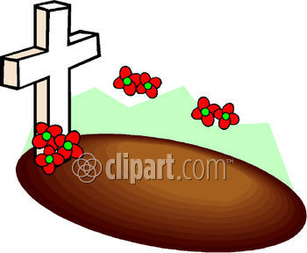
Establishment of Solomon (David Dies)
1 Kings 1–2
The Shunammite
(1:1-4)
The Rebellion of Adonijah (1:5-31)
Coronation of Solomon (1:32-53)

Slide 16
Slides on
1 Kings 2

Slide 17
Establishment of Solomon (David Dies)
1 Kings 1–2
The Shunammite
(1:1-4)
The Rebellion of Adonijah (1:5-31)
Coronation of Solomon (1:32-53)
David's Instruction To Solomon (2:1-9)
David's Death (2:10-11)

Slide 18
Slides on
1 Kings 3

Slide 19
Book Chart
Division of the Kingdom
Late United Kingdom |  |  | Early Divided Kingdom
Chapters 1–11 |  |  | Chapters 12–22
Solomon |  |  | Split
Mostly Obedience |  |  | Mostly Disobedience
Yahweh Worship |  |  | Idol Worship
Kingdom in Tranquility |  |  | Kingdom in Turmoil
Single Capital: Jerusalem |  |  | Israel's Capital: Samaria Judah's Capital: Jerusalem
40 Years (971-931 BC) |  |  | 80 Years (931-852 BC)
Established:Purging 1–2 | Rise: Obedience 3–8 | Decline: Disobedience 9–11 | "J & R" Kings 12–14 | Other Kings 15:1 – 16:28 | Ahab vs. Elijah 16:29 – 22:40 | Other Kings 22:41- 53
219

Slide 20
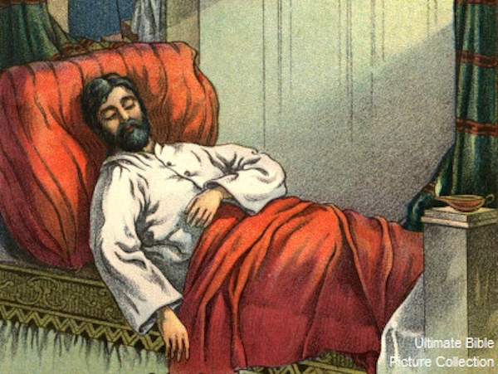
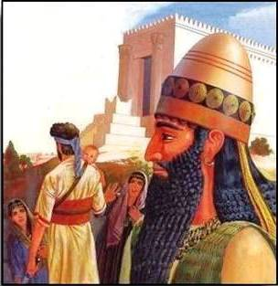
Solomon Asks for Wisdom
1 Kings 3:1-15

Slide 21
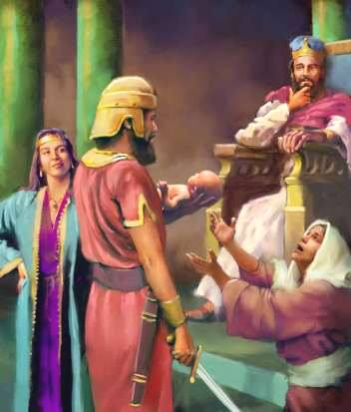
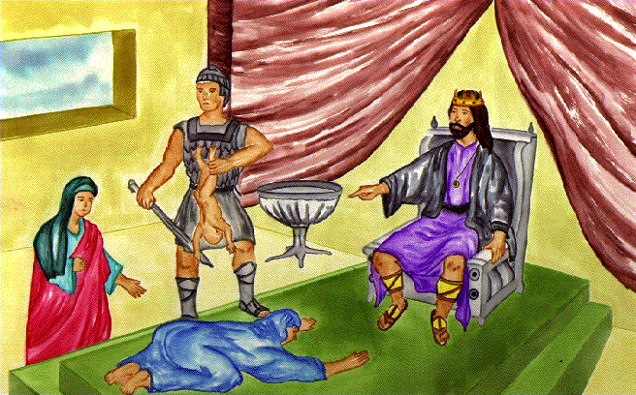
Rise of Solomon
1 Kings 3–8
Endowment of Wisdom (3:1-28)

Slide 22
Slides on
1 Kings 4

Slide 23
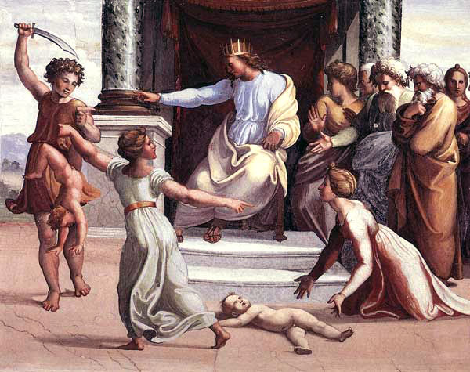
Rise of Solomon
1 Kings 3–8
Organization of the Kingdom
(4:1-34)
The Building of the Temple
(5:1–6:38)

Slide 24
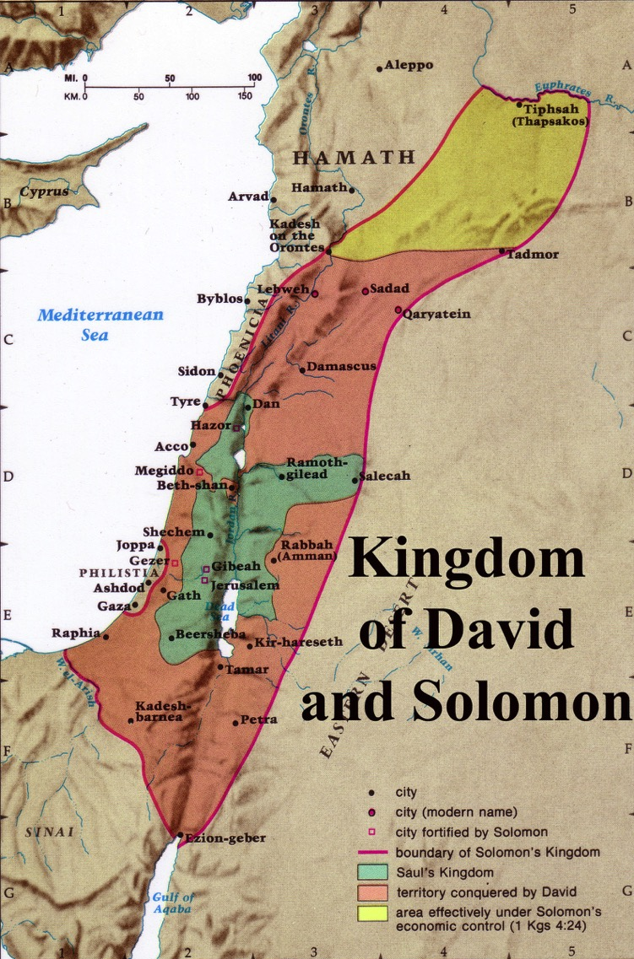
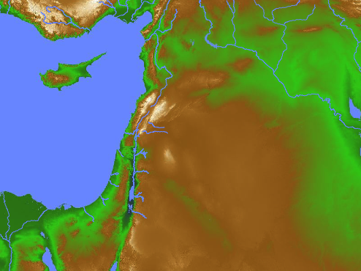
Kingdom of David & Solomon (1 Kings 4:21)
Notes:
God’s promised land stretched northeard from the small wadi of Egypt south in the Sinai to the large Euphrates River in the far north—a HUGE piece of real estate! This is the Golden Age of Israel where they had the largest territory ever.

Slide 25
Slides on
1 Kings 5
Notes:
Having rest on all sides, Solomon could then focus on the most amazing building project of his time.

Slide 26

Old City aerial from north
2 Sam. 24:18-24; 2 Chron. 3:1
The Temple Mount: Jerusalem's Global Focal Point
9.7.03d.
©2006 TBBMI
27
Notes:
Flying closer, you would see on that Temple Mount the golden-roofed Islamic Dome of the Rock. Also known as Mount Moriah and Mount Zion, this site marks the location of the First Temple of King David and the later Second Temple – built by King Herod the Great -- around which Our Lord ministered to the multitudes. To the far left are the Mount of Olives and the Garden of Gethsemane.

Slide 27
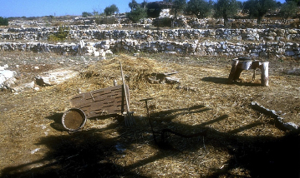
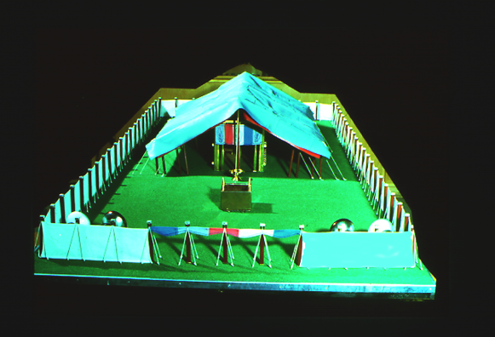

2 Sam. 24:18-24; 2 Chron. 3:1
Ancient Threshing Floor
Araunah's threshing floor…
David bought it…
To build the FIRST Temple to the Lord!
On Mount Moriah!
28
5
©2006 TBBMI
9.7.03d.
Notes:
And the Temple Mount itself…47 acres of unending international intrigue, strife and dispute…currently controlled by local Moslem authorities. The octagonal Dome of the Rock has occupied this site for 1,400 years! Now…
//// Imagine this place without the Dome of the Rock…3,000 years ago, on the top of Mount Moriah…the same Moriah where Abraham had taken Isaac for sacrifice a thousand years earlier than that.
//// In David's time, it had become a threshing floor owned by a man named Araunah.
//// David bought that threshing floor from Araunah – similar to this one – on which to build a great worship center…because ever since the time of Moses…
//// …the old tabernacle, housing the sacred Ark of the Covenant, had existed in the fierce winds of the desert. David wanted to see the Furniture of the Lord protected in a fine building…
//// …such as a great Temple to the Lord there on Mount Moriah.

Slide 28


King David planned it.
1 Kings 5:5
ROYALTY
S - D - S
But…his son Solomon was to build it!
Handbook pg. 32-37
29
1
Notes:
So David planned the Temple and brought supplies into town to build it. However, God did not allow David to erect it because he had spilled human blood.
//// It then became an assignment from God that David's son, Solomon, should build the First Temple.

Slide 29

Israel's "First" Temple
1 Kings 5:5
ROYALTY
S - D - S
Handbook pg. 32-37
30
Notes:
Of course, we have no picture of that Temple. However, this painting shows us its probable grandeur and beauty.

Slide 30
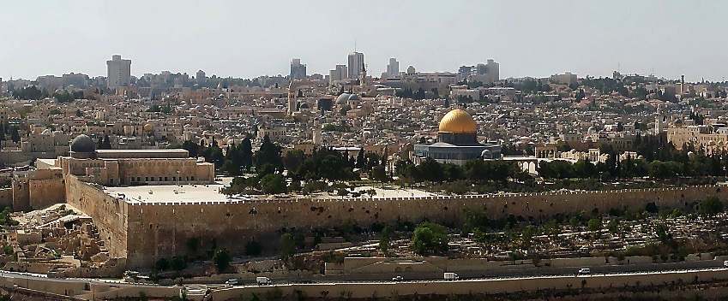
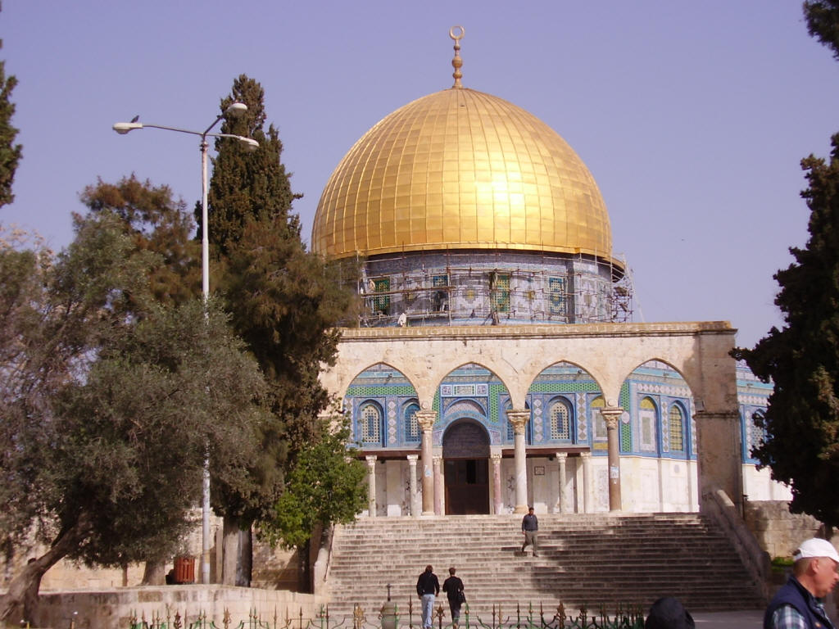
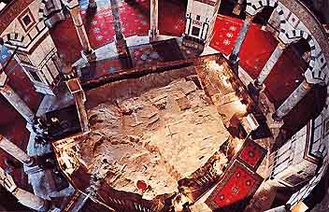
Jerusalem's Temple Mount Today
Inside the Dome of the Rock
Dome of the Rock on The Temple Mount
Handbook pg. 32-37
32a
1
Notes:
Here is the octagonal shrine as you would approach it from the south, leaving the famed El Aqsa Mosque, also held by Islam to be one of its most holy sites.
//// Inside the Dome, looking downward, is "The Rock" from which Mohammed is said to have gone to the "Seventh Heaven" on a ladder. The building is covered throughout with hundreds of colorful carpets, its ancient roof supported by a multitude of stone columns.

Slide 31
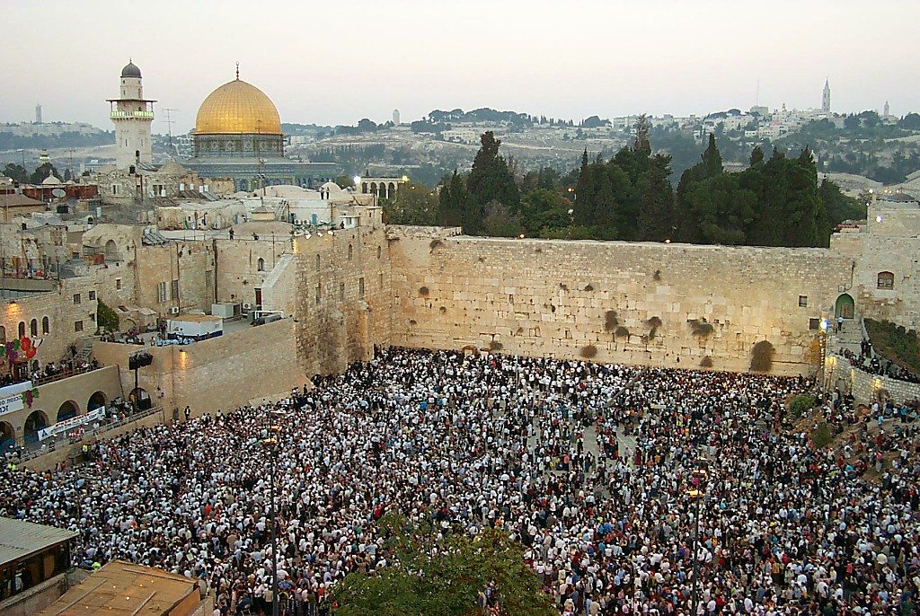
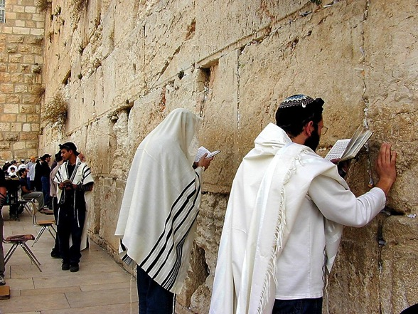
The Western Wall of the Temple Mount
1 Kings 6:14-38
Praying at The Wall
ROYALTY
S - D - S
Handbook pg. 32-37
33
1
Notes:
Directly below the great pavement is the Western Wall today. There are stones here from all the periods of Jerusalem's ancient history.
//// To Jewish people, like these multitudes at prayer, there is no place on the face of the earth more spiritually significant and historically important than right here. On the pavement above the Wall, where the cedars now grow, the great Second Temple stood and Jesus ministered to the multitudes of His day.

Slide 32
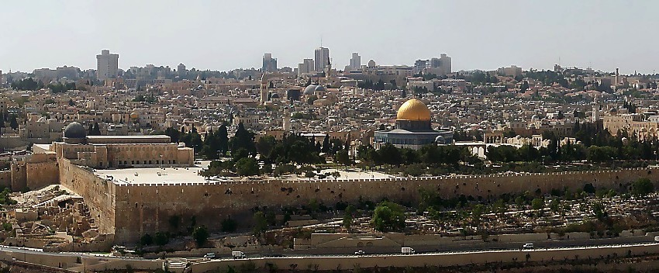

THE ENORMOUS IMPORTANCE OF THE TEMPLE MOUNT!
1 Kings 6:14-38; Matt 21:12-17
• Spiritual
• Theological
• Political
• Geographical
ROYALTY
S - D - S
• Eschatological
Handbook pg. 32-37
34
6
Notes:
So now…every time you see news footage of Jerusalem, reports of its internal conflicts between Jews and Arabs…just remember the enormous importance of the Temple Mount…the center of it all…
//// The First Temple of King David, the Second Temple built for the Jews by Zerubbabel and expanded by King Herod the Great. Finally, today, the Moslem Dome of the Rock and El Aqsa Mosque stand on this site. This small acreage was…
//// Israel's SPIRITUAL center and ritual focus…
//// its THEOLOGICAL and ritual cornerstone…
//// the POLITICAL center of the Jewish universe…
//// the GEOGRAPHICAL center of the Abraham's inheritance…and
//// for all believers, a key to our understanding of the events of the End Times…that being, the study of Biblical ESCHATOLOGY.

Slide 33

The Temple Mount in Today's Jerusalem:
A Prime Focal Point of Planet Earth
1 Kings 6:14-38; Matt 21:12-17
Handbook pg. 32-37
35
Notes:
Now we can pull back and view the entire Jerusalem panorama with much greater appreciation of all that has happened there. The Temple Mount of today's Jerusalem continues as the tightly focused center of world concern as the sons of Sarah and the sons of Hagar continue their ancient dispute in the land where it all began!

Slide 34
Slides on
1 Kings 6

Slide 35
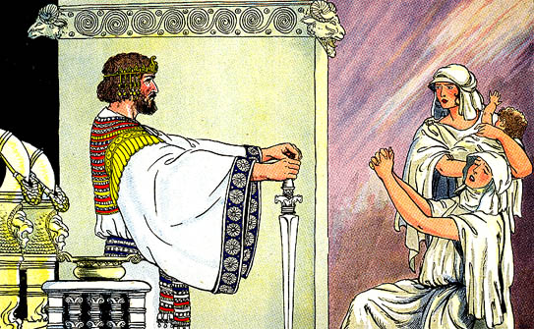
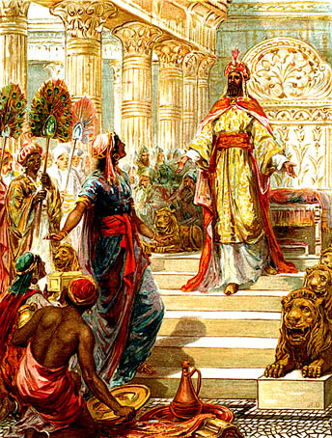
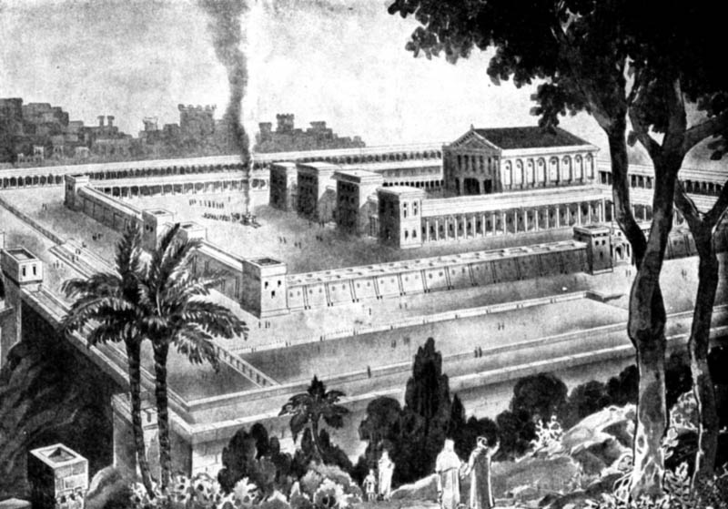
Solomon's Wisdom & Glory
(1 Kings 3–8)

Slide 36
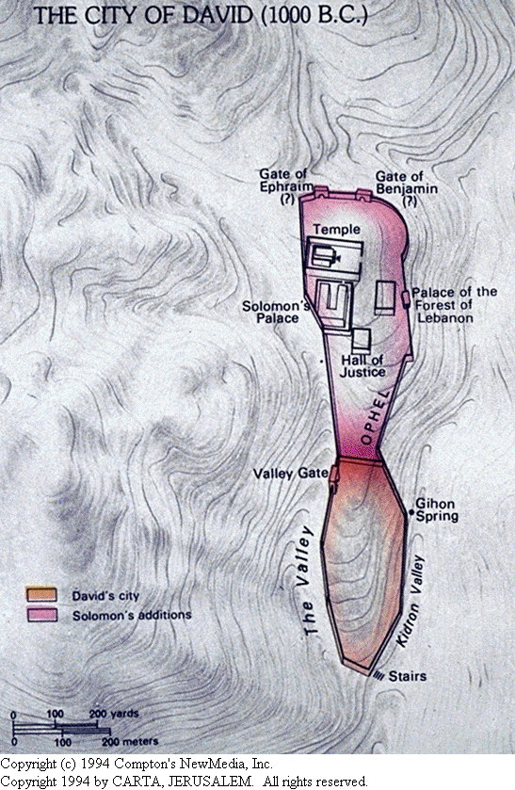
Jerusalem expands north

Slide 37
The Temple

Slide 38
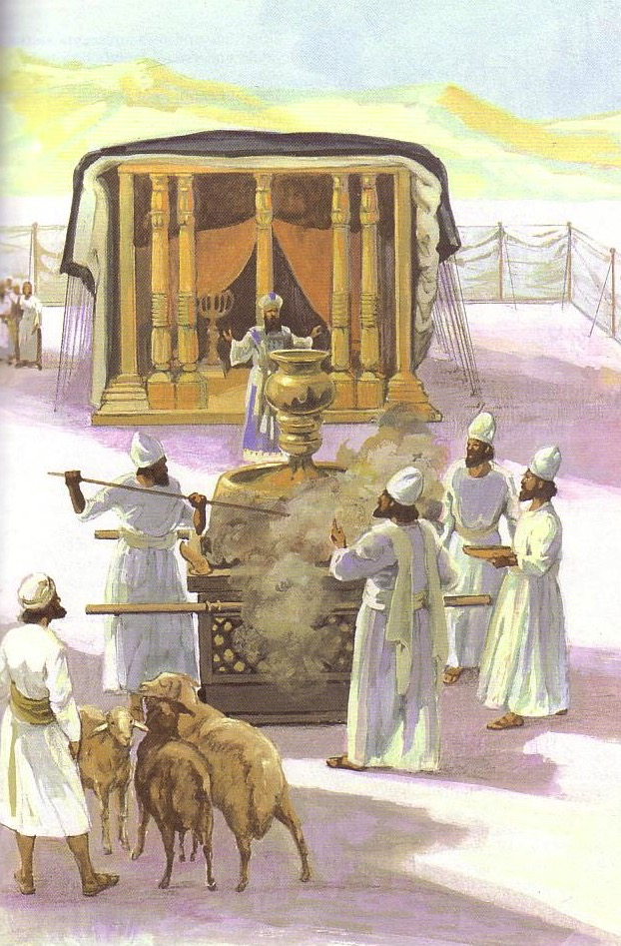
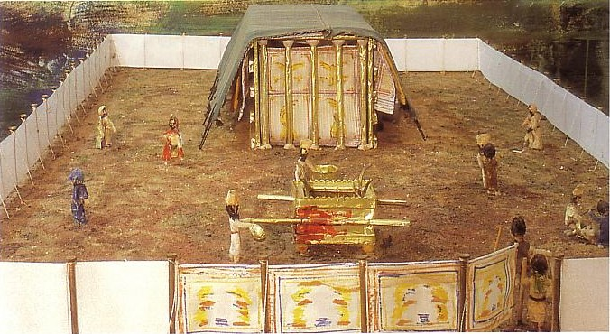
The Tabernacle

Slide 39
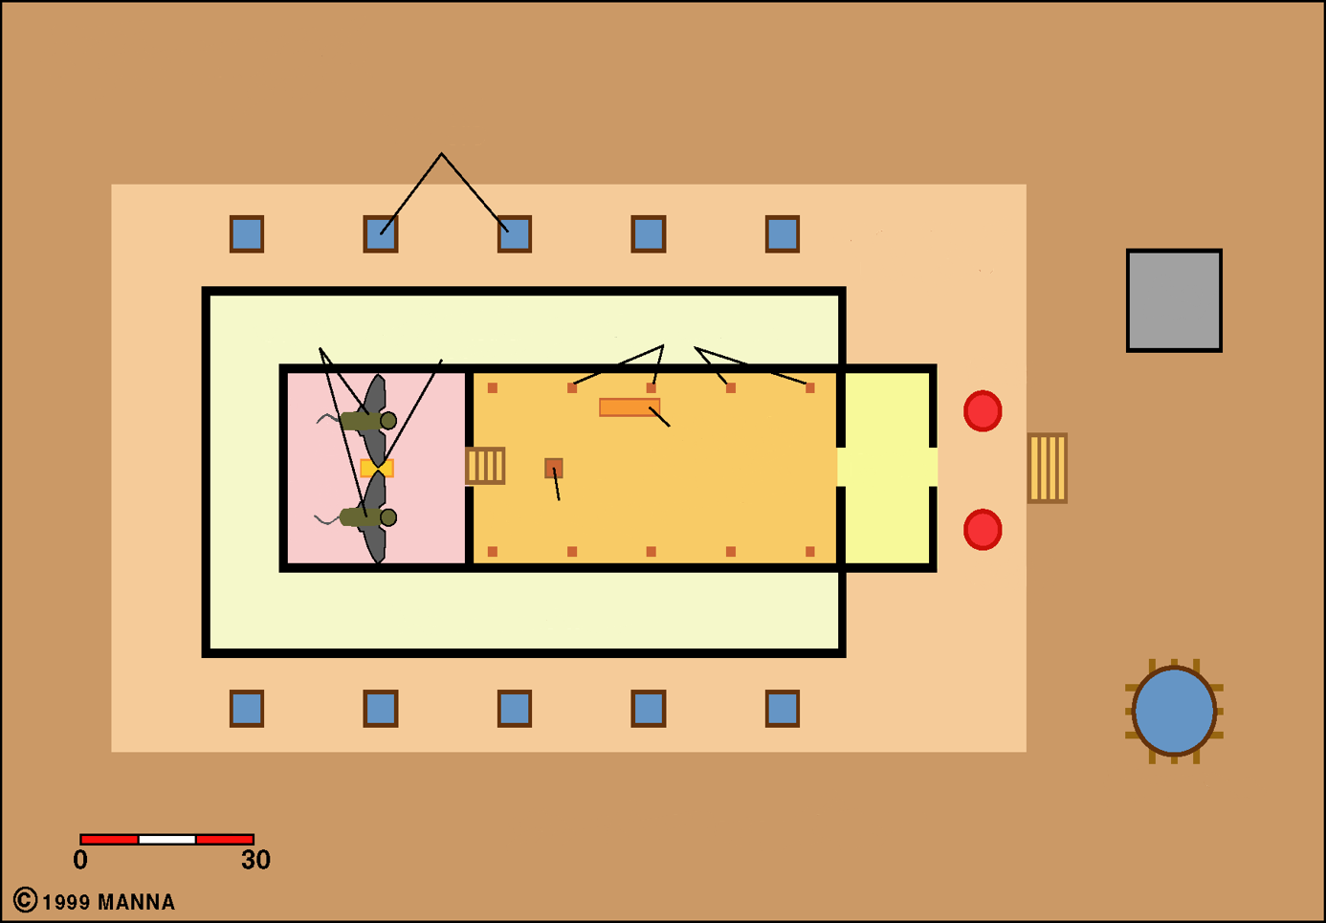

Solomon's Temple
Lavers
Court of Priests
Ark of the Covenant
Altar
Cherubim
Candlesticks
Boaz
Holy of
Holies
Table of Showbread
Holy Place
Porch
Incense Altar
Jachin
Storerooms
Cubits
Bronze Sea
Court of Israelites

Slide 40
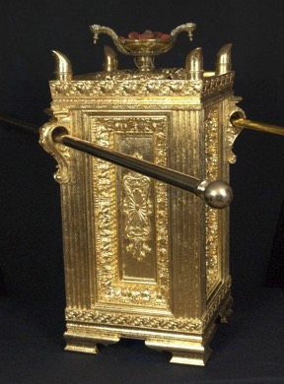
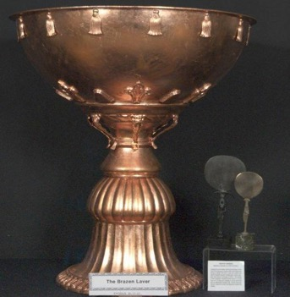
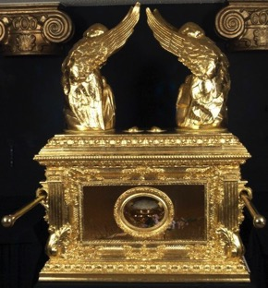
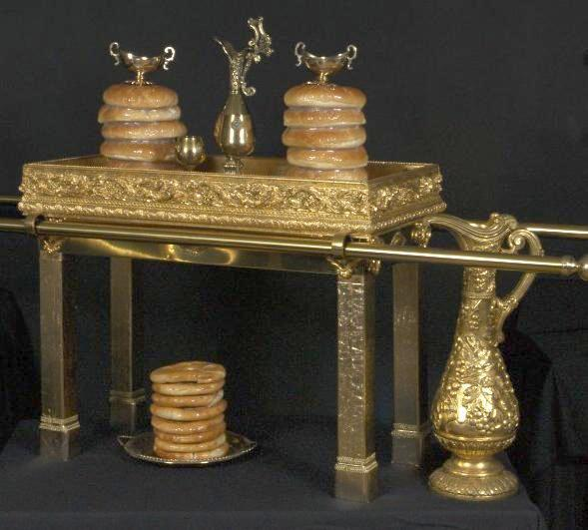
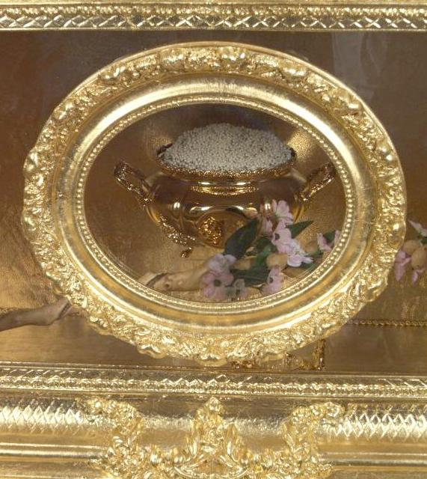
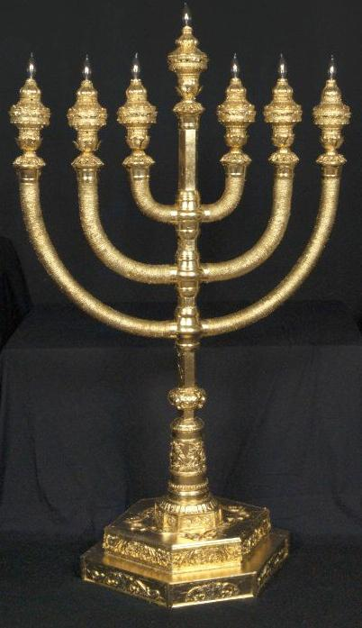
Temple Furnishings (7:9-51)
Rise of Solomon
1 Kings 3–8
Golden pot of manna
Altar of incense
Golden candle stick
The ark of the covenant
Table for the
bread of presence
Brazen laver

Slide 41
Slides on
1 Kings 7

Slide 42
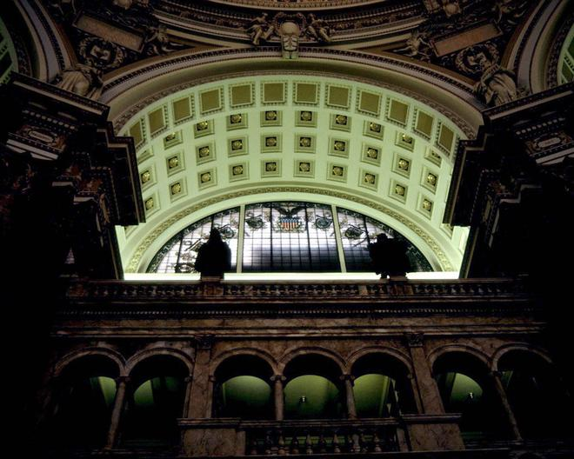
Rise of Solomon
1 Kings 3–8
Solomon's Palace (7:1-8)

Slide 43
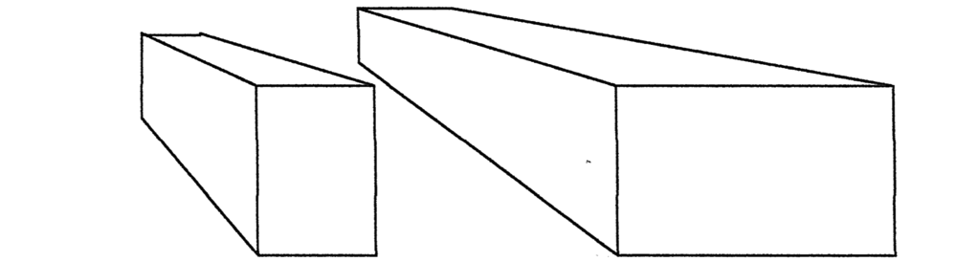
Comparing Buildings
224
Solomon’s… | Temple (1 Kings 6:1-2) | Palace (1 Kings 7:1-2)
Height | 30 cubits (13.5 meters) | 30 cubits (13.5 meters)
Width | 20 cubits (9 meters) | 50 cubits (23 meters)
Length | 60 cubits (27 meters) | 100 cubits (46 meters)
Construction | 966-959 BC (7 years; 1 Kings 6:38) | 959-946 BC (13 years; cf. Hag 1:2-4)
Location | Rock of Moriah: place where Abraham offered Isaac (Gen 22:14), later the threshing floor of Araunah (2 Sam 24:16), and later the temple (1 Chron 22:1; 2 Chron 3:1) | Just south of the temple, which was next to the palace of Pharaoh’s daughter, wife of Solomon (2 Chron 8:11)

Slide 44
Slides on
1 Kings 8

Slide 45

The Great Sea was supported by 12 oxen

Slide 46
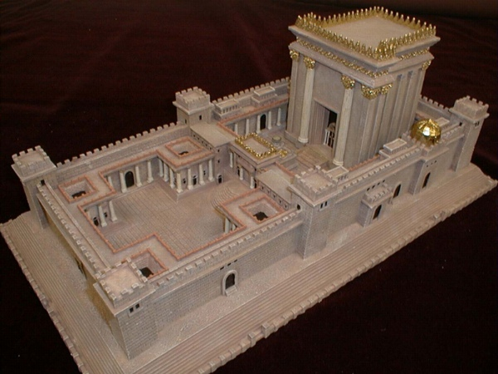
Rise of Solomon
1 Kings 3–8
The Dedication of The Temple (8:1-66)

Slide 47
Slides on
1 Kings 9

Slide 48
Book Chart
Division of the Kingdom
Late United Kingdom |  |  | Early Divided Kingdom
Chapters 1–11 |  |  | Chapters 12–22
Solomon |  |  | Split
Mostly Obedience |  |  | Mostly Disobedience
Yahweh Worship |  |  | Idol Worship
Kingdom in Tranquility |  |  | Kingdom in Turmoil
Single Capital: Jerusalem |  |  | Israel's Capital: Samaria Judah's Capital: Jerusalem
40 Years (971-931 BC) |  |  | 80 Years (931-852 BC)
Established:Purging 1–2 | Rise: Obedience 3–8 | Decline: Disobedience 9–11 | "J & R" Kings 12–14 | Other Kings 15:1 – 16:28 | Ahab vs. Elijah 16:29 – 22:40 | Other Kings 22:41- 53
219

Slide 49
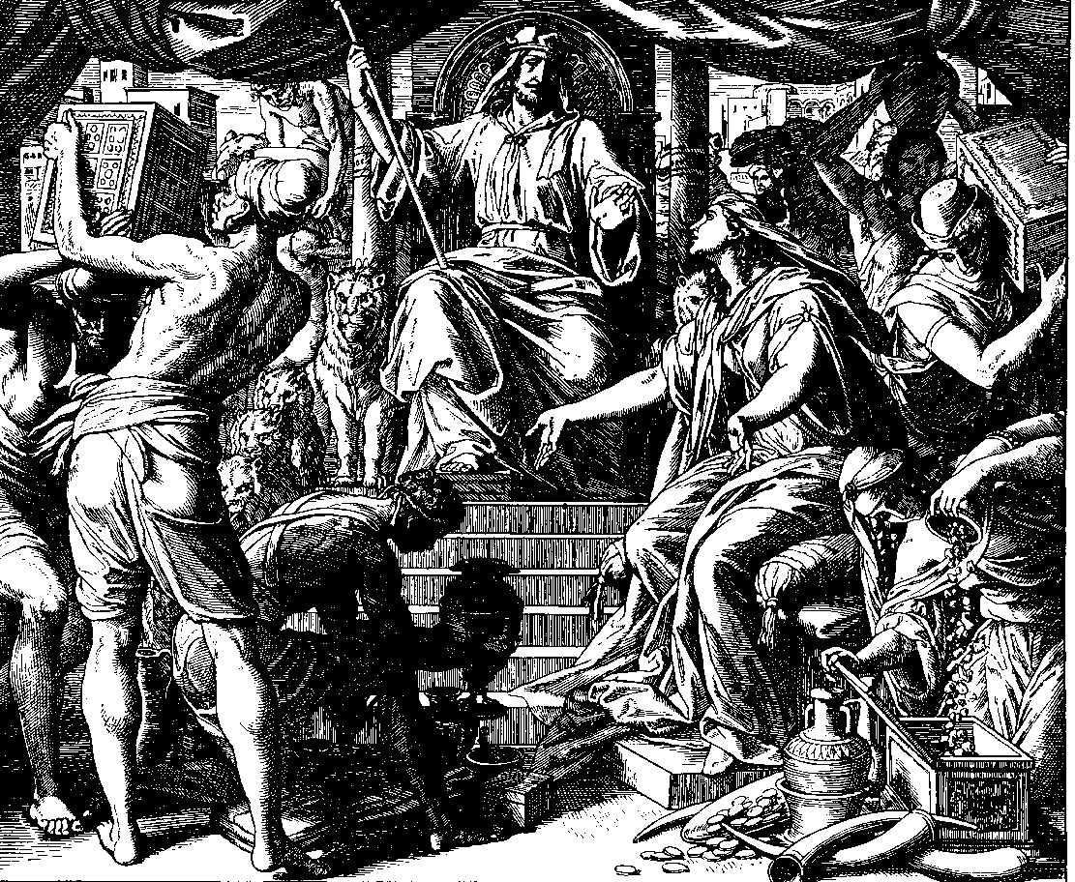
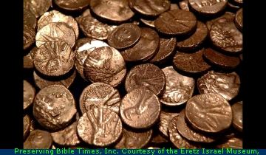
Decline of Solomon
1 Kings 9–11
225
1. God reaffirms the Davidic Covenant (9:1-9)
2. Compromises
(9:10–11:8)
Cities given away
Slavery
Wealth
Horses
Intermarriage
Multiple wives
Coins from Tyre
3. God's Chastening (11:9-43)

Slide 50
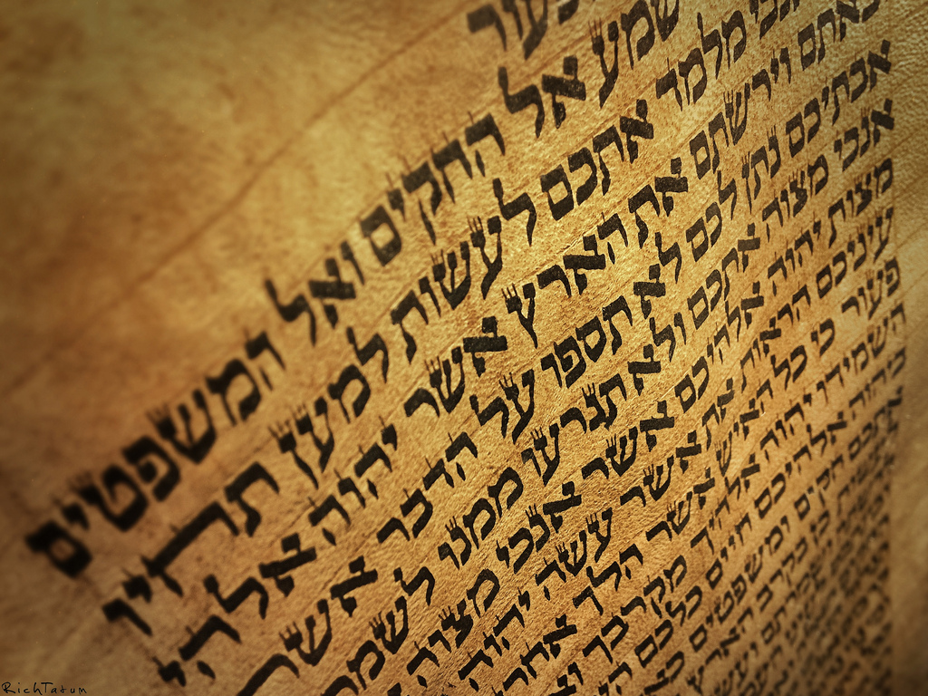
Warnings for Kings (1400 BC)
"When he sits on the throne as king, he must copy for himself this body of instruction on a scroll in the presence of the Levitical priests.
¹⁹He must always keep that copy with him and read it daily as long as he lives. That way he will learn to fear the LORD his God by obeying all the terms of these instructions and decrees"
(Deut. 17:18-19 NLT).

Slide 51
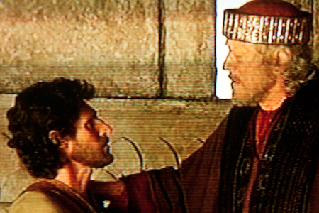
Warnings for Kings (1400 BC)
"This regular reading will prevent him from becoming proud and acting as if he is above his fellow citizens. It will also prevent him from turning away from these commands in the smallest way"
"And it will ensure that he and his descendants will reign for many generations in Israel"
(Deut. 17:20 NLT).

Slide 52
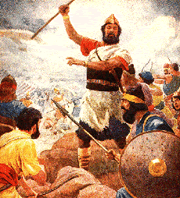
Warnings for Kings (1400 BC)
"You are about to enter the land the LORD your God is giving you. When you take it over and settle there, you may think, 'We should select a king to rule over us like the other nations around us.' ¹⁵ If this happens, be sure to select as king the man the LORD your God chooses. You must appoint a fellow Israelite; he may not be a foreigner"
(Deut. 17:14-15 NLT).

Slide 53
Slides on
1 Kings 10

Slide 54
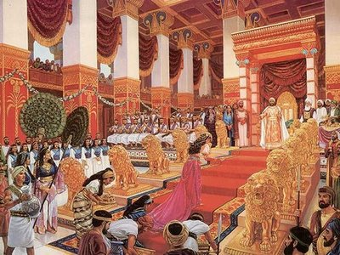
The Queen of Sheba
1 Kings 10:1 When the queen of Sheba heard of Solomon's fame, which brought honor to the name of the LORD, she came to test him with hard questions.

Slide 55
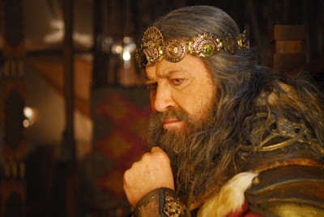
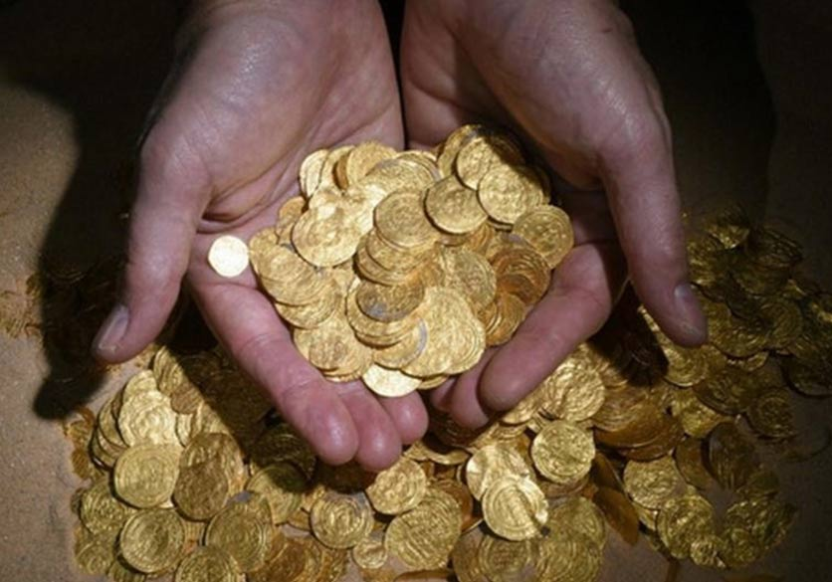
Warnings for Kings (1400 BC)
"And he must not accumulate large amounts of wealth in silver and gold for himself"
(Deut. 17:17b NLT).

Slide 56
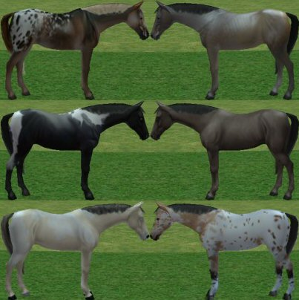
Warnings for Kings (1400 BC)
"The king must not build up a large stable of horses for himself or send his people to Egypt to buy horses, for the LORD has told you, 'You must never return to Egypt'"
(Deut. 17:16 NLT).

Slide 57
Slides on
1 Kings 11

Slide 58
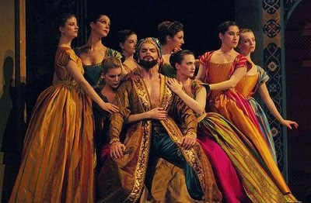
Warnings for Kings (1400 BC)
"The king must not take many wives for himself, because they will turn his heart away from the LORD"
(Deut. 17:17a NLT).

Slide 59
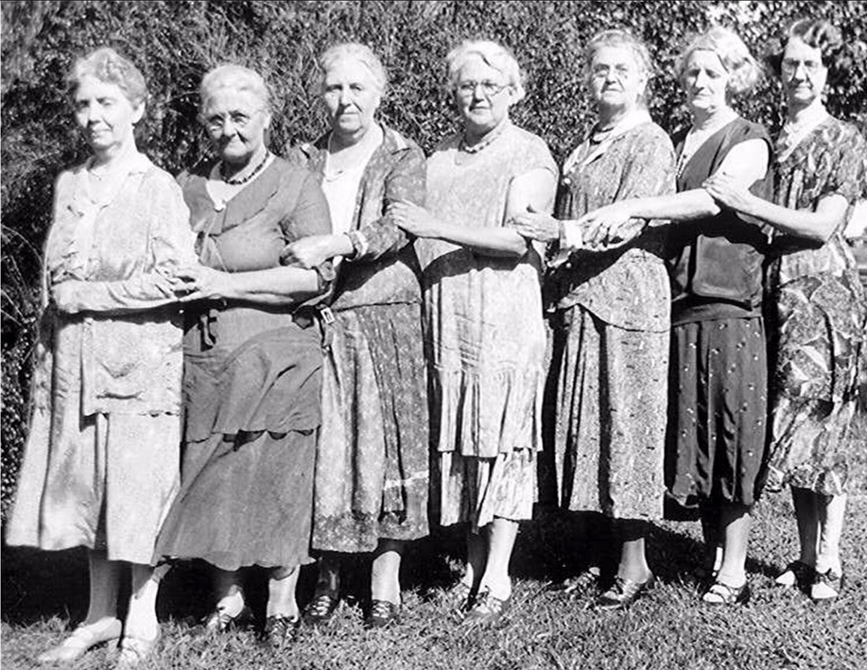
Solomon's Wives

Slide 60

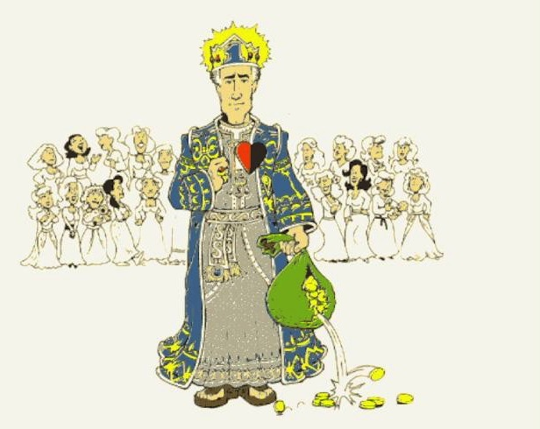
Women and money turned Solomon's heart away

Slide 61
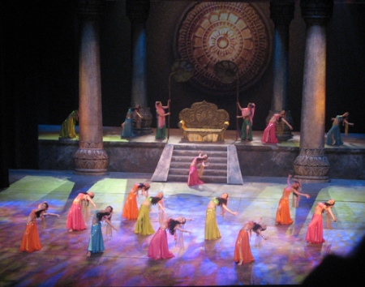
Decline of Solomon
1 Kings 9–11
Solomon's Apostasy Due to Wives (11:1-3)

Slide 62
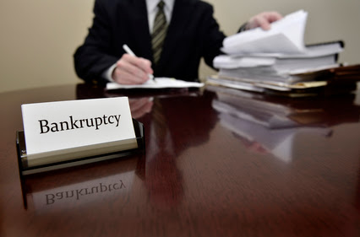
Chapter 11 = Bankruptcy
Bankruptcy

Slide 63
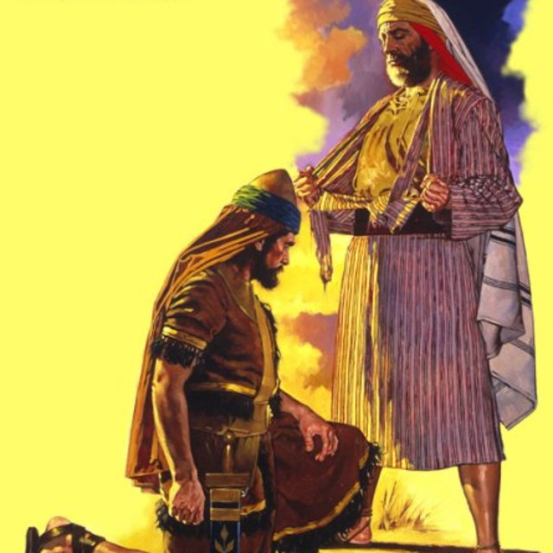
Solomon's Enemies
(1 Kings 11:26-40)

Slide 64

Decline of Solomon
1 Kings 9–11
Solomon's Death

Slide 65
The Significance of 1 Kings 12
225
The Kingdom in Tranquility | Chapter 12 | The Kingdom in Turmoil
God rules His people through a king: SOLOMON | Split of the Kingdom | God speaks to His people through a prophet: ELIJAH
Irving L. Jensen, Jensen’s Survey of the OT, 196

Slide 66

A Shaky Kingdom
140
Phoenicia
Aram
2 Samuel 19
David returned to a restored kingdom in Jerusalem but the north-south division persisted.
Israel
Ammon
Philistia
Judah
Moab
Egypt
Edom

Slide 67

Tribal Loyalties
171
Asher
Naphtali
2 Samuel 19
Zebulun
Manasseh
Issachar
Manasseh
Gad
Ephraim
Dan
Benjamin
Reuben
Judah
Simeon

Slide 68
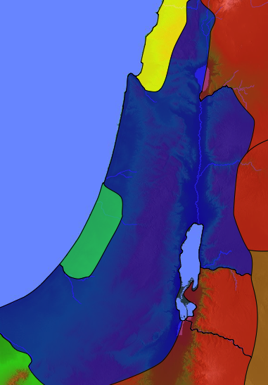
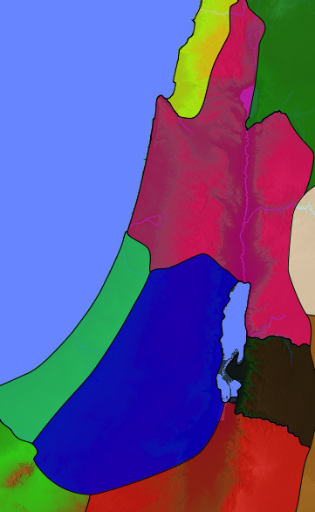
United to Divided
Kingdom
1 Kings 12
Israel
Israel
Judah

Slide 69
Divided Kingdom
140
Phoenicia
Aram
1 Kings 12
Jeroboam received
10 northern tribes
Rehoboam received
2 southern tribes
Israel
Ammon
Philistia
Judah
Moab
Egypt
Edom

Slide 70

SOLOMON: REALLY BIG IDEAS!
7
ROYALTY
ca. 1000 B.C.
S - D - S
DC
2 Sam. 7:4-16
1 Chron. 17:3-15
A R C
ROYALTY
S - D - S
BIG ISSUE: BILLS COMING DUE.
Handbook pg. 32-37
36
6
Notes:
Now back to the throne of international Israel in 1000 BC. Main players…
//// S-D-S...SAUL…the first anointed king, and not a very successful one at that.
//// While still living, old Samuel then anoints young DAVID, who follows SAUL to the throne. DAVID is then succeeded on Israel's throne by one of his many sons,
//// SOLOMON, born through Bathsheba. Under SOLOMON's rule,
//// the great Solomonic Temple is built, and united Israel arises as a national power and a center of enormous wealth and international influence. SOLOMON becomes internationally known for his wisdom and for his ambitious building projects.
//// He had some really big ideas…erected at great cost to his kingdom. But the question finally had to be answered…
//// when the bills came due: who paid for all that? The people…of course…as they always do…through high taxes and/or forced labor.

Slide 71
Solomon's Problems
1 Kings 9, 10, 11
7
ROYALTY
ca. 1000 B.C.
S - D - S
DC
Construction!
Heavy Taxation!
Bankruptcy!
Idolatry!
2 Sam. 7:4-16
1 Chron. 17:3-15
A R C
ROYALTY
S - D - S
Handbook pg. 32-37
37
4
Notes:
Solomon carried out a
//// construction program that was the envy of every king in the region.
//// But, in spite of his great wisdom, SOLOMON pays for it all through the burdens of enormous taxation which,
//// in the end, sent the country into bankruptcy…resulting in huge resentment on the part of the people toward their national government!
//// And if there were not enough problems: he himself fell into idolatry.

Slide 72




IDOL WORSHIP!
1 Kings 11:4-13
ROYALTY
The Mount of Olives
ca. 1000 B.C.
S - D - S
DC
2 Sam. 7: 4-16
1 Chron. 17:3-15
A R C
The Temple Mount
ROYALTY
S - D - S
Handbook pg. 32-37
38
4
Notes:
Why? Along with Solomon's many foreign treaties he had also acquired many foreign wives from the country with which he made the treaty. The new wives moved into Jerusalem bringing with them their idolatrous religious practices.
//// On that site of today's Temple Mount…after SOLOMON had completed the first Temple to the God of Israel – and worshiped there - he later could be seen…
//// …over on The Mount of Olives across the Kidron Valley from his newly built temple…
//// worshipping the pagan gods brought into town by those foreign wives.
//// So…once again…idol worship entered the day to day life of ancient Israel, foreshadowing other great national problems to come

Slide 73
After Solomon...
7
1 Kings 12:25 through 14:31
ROYALTY
ca. 1000 B.C.
S - D - S
DC
<<<< SPLIT >>>>
NORTH SOUTH
2 Sam. 7: 4-16
1 Chron. 17:3-15
A R C
ISRAEL JUDAH
10 2
ROYALTY
S - D - S
••• SPLIT •••
North South
Israel
Judah
10 2
Handbook pg. 32-37
39
3
Notes:
Upon the death of King SOLOMON, there was a vacuum of strong central leadership in Jerusalem.
//// There soon erupted a civil war... followed by a national SPLIT.
//// Quickly, the UNITED kingdom of the Israel of Saul, David, and Solomon...tears apart…becoming the TWO divided kingdoms of the NORTH and the SOUTH...as both descend into increasingly greater sin and spiritual separation from God.
//// TEN tribes join together to become known as the NORTHERN Kingdom, called ISRAEL, while the remaining TWO tribes (BENJAMIN and JUDAH) unite to become the SOUTHERN Kingdom of JUDAH. The Northern Kingdom was the larger…it retained the name ISRAEL.

Slide 74

A Kingdom Split
7
1 Kings 12:25 through 14:31
THE NORTHERN KINGDOM:
ISRAEL
10 TRIBES
SAMARIA
ROYALTY
S - D - S
••• SPLIT •••
JERUSALEM
North South
2 TRIBES
Israel
Judah
10 2
THE SOUTHERN KINGDOM:
JUDAH
Handbook pg. 32-37
40
1
Notes:
As a result of the national split…the 10 tribes of the Northern Kingdom, Israel, move their capital north into the region known, even today, as Samaria...
//// …while the two Southern Kingdom tribes, Judah and Benjamin, retain their national capital in Jerusalem.
So...now...the period of ROYALTY continues, but permanently split nationally between the two kingdoms, ISRAEL IN THE NORTH and JUDAH IN THE SOUTH.
Old alliances and ancient tribal relationships come alive as gross sin, idolatry and separation from God and the Law continue to grow and spread through both kingdoms, especially ISRAEL in the North.
Now it's clear to see that the Israel BEFORE the national split was an entirely different nation -- IN CHARACTER AND NATIONAL STYLE -- than that AFTER the split. That is a key idea toward keeping things straight in the Old Testament AFTER King Solomon.

Slide 75
Why does unity sometimes lead to division?
I. Idolatry leads to division
(1 Kings 1–11; 971-931 BC).
Idolatry
Division
Notes:
Why does unity sometimes lead to division? What causes this to happen? The vital part is the foundation.

Slide 76
Why does unity sometimes lead to division?
II. Ignoring God's Word leads to division
(1 Kings 12–22; 931-852 BC).
Idolatry
Ignore God's Word
Division
Notes:
God’s work destabilizes when we ignore God’s Word.

Slide 77
Slides on
1 Kings 12

Slide 78


Early Divided Kingdom
1 Kings 12:1–16:28
Disruption of the Kingdom at Shechem (12:1-24)

Slide 79
Book Chart
Division of the Kingdom
Late United Kingdom |  |  | Early Divided Kingdom
Chapters 1–11 |  |  | Chapters 12–22
Solomon |  |  | Split
Mostly Obedience |  |  | Mostly Disobedience
Yahweh Worship |  |  | Idol Worship
Kingdom in Tranquility |  |  | Kingdom in Turmoil
Single Capital: Jerusalem |  |  | Israel's Capital: Samaria Judah's Capital: Jerusalem
40 Years (971-931 BC) |  |  | 80 Years (931-852 BC)
Established:Purging 1–2 | Rise: Obedience 3–8 | Decline: Disobedience 9–11 | "J & R" Kings 12–14 | Other Kings 15:1 – 16:28 | Ahab vs. Elijah 16:29 – 22:40 | Other Kings 22:41- 53
219

Slide 80

Division of the Kingdom
A family divides…

Slide 81

Map of the Divide
Levi
Dan
10 tribes (includes migrated tribe of Simeon)
Naphtali
Asher
Zebulun
Issachar
Manasseh
Israel
Ephraim
Gad
Benjamin
Reuben
Judah
Judah
Simeon
2 tribes (Simeon migrated & Benjamin very small)

Slide 82

Inventing Paganism...
Dan
Jeroboam set up calf idols at Bethel and Dan (1 Kings 12:26-33)
Bethel
Jerusalem

Slide 83
Slides on
1 Kings 13

Slide 84

The Golden Calf

Slide 85


Early Divided Kingdom
1 Kings 12:1–16:28
Altar of Jonathan (grandson of Moses) in 1340 BC (Judges 18:30)
Jeroboam set up his golden calf on the very same altar in 931 BC (1 Kings 12:26-33)!
The Israelite Kingdom Begins Under Jeroboam (12:25–14:20)
Tel Dan

Slide 86

Early Divided Kingdom
1 Kings 12:1–16:28
Jeroboam's altar split in half (1 Kings 13:1-5, 31-32)
Tel Dan

Slide 87
Slides on
1 Kings 14

Slide 88

Early Divided Kingdom
1 Kings 12:1–16:28
Jeroboam's wife identified by the blind prophet Ahijah to predict her son Abijah's death (14:1-18)

Slide 89

Early Divided Kingdom
1 Kings 12:1–16:28
Judgment by Egypt & Mixed Kings (14:21–15:24)
Five Evil Kings of Israel (15:25–16:21)

Slide 90
Slides on
1 Kings 15

Slide 91
Book Chart
Division of the Kingdom
Late United Kingdom |  |  | Early Divided Kingdom
Chapters 1–11 |  |  | Chapters 12–22
Solomon |  |  | Split
Mostly Obedience |  |  | Mostly Disobedience
Yahweh Worship |  |  | Idol Worship
Kingdom in Tranquility |  |  | Kingdom in Turmoil
Single Capital: Jerusalem |  |  | Israel's Capital: Samaria Judah's Capital: Jerusalem
40 Years (971-931 BC) |  |  | 80 Years (931-852 BC)
Established:Purging 1–2 | Rise: Obedience 3–8 | Decline: Disobedience 9–11 | "J & R" Kings 12–14 | Other Kings 15:1 – 16:28 | Ahab vs. Elijah 16:29 – 22:40 | Other Kings 22:41- 53
219

Slide 92

Descendants of Solomon

Slide 93
Slides on
1 Kings 16

Slide 94
Judah
Israel
Rehoboam 931-913
Abijam 913-911
Asa 911-870
Jehoshaphat 874-848
Jeroboam I 931-910
Nadab 910-909
Baasha 909-886
Elah 886-885
Zimri 885
Tibni 885-880
Omri 885-874
Ahab 874-853
Ahaziah 853-852

Slide 95
Placing the Prophets
342
Placing Key People & Dates
Key Dates
Jeroboam
Saul
David
Solomon
931
Rehoboam
Hoshea
722
Josiah
Zedekiah
586

Slide 96
Ahab & Jezebel import Baal worship to Israel (1 Kings 16:29-34)
Importing Paganism...
Dan
Baal
Jeroboam set up calf idols at Bethel and Dan (1 Kings 12:25-33)
Bethel
Jerusalem

Slide 97
Book Chart
Division of the Kingdom
Late United Kingdom |  |  | Early Divided Kingdom
Chapters 1–11 |  |  | Chapters 12–22
Solomon |  |  | Split
Mostly Obedience |  |  | Mostly Disobedience
Yahweh Worship |  |  | Idol Worship
Kingdom in Tranquility |  |  | Kingdom in Turmoil
Single Capital: Jerusalem |  |  | Israel's Capital: Samaria Judah's Capital: Jerusalem
40 Years (971-931 BC) |  |  | 80 Years (931-852 BC)
Established:Purging 1–2 | Rise: Obedience 3–8 | Decline: Disobedience 9–11 | "J & R" Kings 12–14 | Other Kings 15:1 – 16:28 | Ahab vs. Elijah 16:29 – 22:40 | Other Kings 22:41- 53
219

Slide 98
Slides on
1 Kings 17

Slide 99


Phoenician Religion
In various cities these deities were known by different names:
Cities | Tyre | Sidon | Byblos
Father god | -- | Baal Shamaym | El
Mother god | Astarte | -- | Baalat
Young male god | Melqart | Eshmun | Adonis

Slide 100

BAAL
CANAANITE HIGH GOD
Prince of the earth, god of fertility, lord of sky and earth, god of thunder and lightning etc
Lord, master, owner
Chief male deity of the Phoenicians and Canaanites
Worshipped in the high places of Moab (Num. 22:41)

Slide 101


Free
Bible
images
ELIJAH FED BY RAVENS
1 Kings 17:1-9

Slide 102


Slide 103


Slide 104


Slide 105


Slide 106


Slide 108


Slide 109


Slide 110


Slide 111


Slide 112


Slide 113


Slide 114


Slide 115


Slide 116


Slide 117


Slide 118

THE WORD IN PICTURES
Free
Bible
images

Slide 119
Slides on
1 Kings 18

Slide 120

Elijah and Obadiah (18:1-15)

Slide 121
Dan
Baal
Elijah confronted 850 prophets at the end of a 3.5 year drought in the land of the "thunder god" and "rain god."
Bethel
Jerusalem

Slide 122

Elijah on Mount Carmel (18:16-46)

Slide 123

Elijah on Mount Carmel (18:16-46)

Slide 124

Free
Bible
images
1 Kings 18:41-46
ELIJAH PRAYS FOR RAIN

Slide 125


Slide 126


Slide 128


Slide 129


Slide 130


Slide 131


Slide 132


Slide 133


Slide 134


Slide 135


Slide 136


Slide 137


Slide 138


Slide 139


Slide 140


Slide 141


Slide 142


Slide 143


Slide 144


Slide 145


Slide 146


Slide 147


Slide 148


Slide 149


Slide 150


Slide 151

Elijah's Run
The power of the LORD came upon Elijah and, tucking his cloak into his belt ...
... he ran ahead of Ahab all the way to Jezreel (18:46)

Slide 152
THE WORD IN PICTURES
Free
Bible
images

Slide 153

Elijah at Sinai
The Lord Appears To Elijah (19:9-18)

Slide 154
Slides on
1 Kings 19

Slide 155

Free
Bible
images
ELIJAH ANOINTS ELISHA TO SUCCEED HIM
1 Kings 19:15-21

Slide 156
Slides on
1 Kings 20

Slide 157

The Israelite-Syrian Wars (20:1–22:53)
Elijah & Ahab
1 Kings 16:29–22:40

Slide 158
Slides on
1 Kings 21

Slide 159

Who was Jezebel?

Slide 160

"But I have this complaint against you. You are permitting that woman—that Jezebel who calls herself a prophet—to lead my servants astray. She teaches them to commit sexual sin and to eat food offered to idols. ²¹I gave her time to repent, but she does not want to turn away from her immorality" (Rev. 2:20-21 NLT)

Slide 161




Naboth's Vineyard
Lust
Request
Plan
Judgment

Slide 162
Slides on
1 Kings 22

Slide 163


Ahab Killed at Ramoth Gilead (22:29-40)
Elijah & Ahab
1 Kings 16:29–22:40

Slide 164

—Main Idea of 1 Kings 22—
Seek the Lord sincerely because ignoring God's clear will has serious results
Notes:
You may face 400 to 1 odds like Micaiah—but you still must obey God .
Frankly, there's only one vote that counts—the Lord's.

Slide 165
1 Kings Key Word
219
Divi sion

Slide 166
Why does unity sometimes lead to division?
Unity
Division
Notes:
Why does unity sometimes lead to division? What causes a unified people to become a divided people? Integral to unity is the foundation.

Slide 167
Main Idea
Our unity is only as strong as our trust in Christ as our foundation.
1 Kings
Notes:
If we stop having Jesus as the basis of this church, we'll end up divided.

Slide 168
Why does unity sometimes lead to division?
I. Idolatry leads to division
(1 Kings 1–11; 971-931 BC).
Idolatry
Division
Notes:
Why does unity sometimes lead to division? What causes this to happen? The vital part is the foundation.

Slide 169
Why does unity sometimes lead to division?
II. Ignoring God's Word leads to division
(1 Kings 12–22; 931-852 BC).
Idolatry
Ignore God's Word
Division
Notes:
God’s work destabilizes when we ignore God’s Word.

Slide 170

Put God First
Notes:
How can you put the Lord first by putting his Word first in the coming year?

Slide 171

Need
Notes:
Some of us won't even commit to read one verse of the Bible each day but we SAY we want God's will!

Slide 172

YouVersion
Notes:
Download YouVersion today and start a reading program tomorrow.
If you don't know where to start, how about next week's sermon text?

Slide 173
Black

Slide 174


OT Preaching link at BibleStudyDownloads.org
Get this presentation and script for free!

